Slide 1
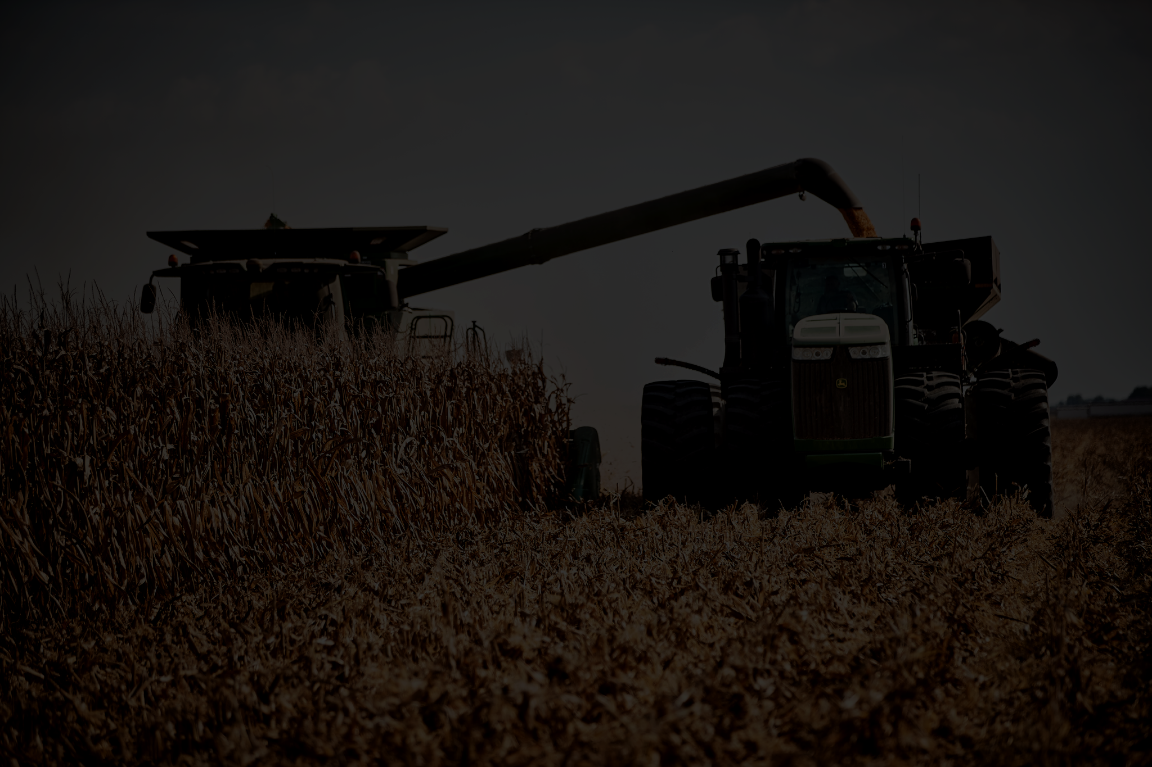
SmartFarms: Crop and Livestock Management System
Kojo (kojo)
Zain (zainmirza)
Tausif (tausifi21)
Alex (alexla)
Chris (chrislam)
Gerald (gerald961)

Slide 2
Brief Introduction…Why Smart Farms?
Motivation:
The agriculture industry is increasingly adopting smart technology to optimize farming practices
Background:
Our Smart Farm Management System is essential, as it helps farmers make data-driven decisions, automate tasks, and enhance overall farm efficiency.
Functionalities::
Crop, soil, & Livestock management
Harvest management
Tools & Equipment management
Pest, Disease, & Emergency management
Sensors & Data Analysis tools

Slide 3
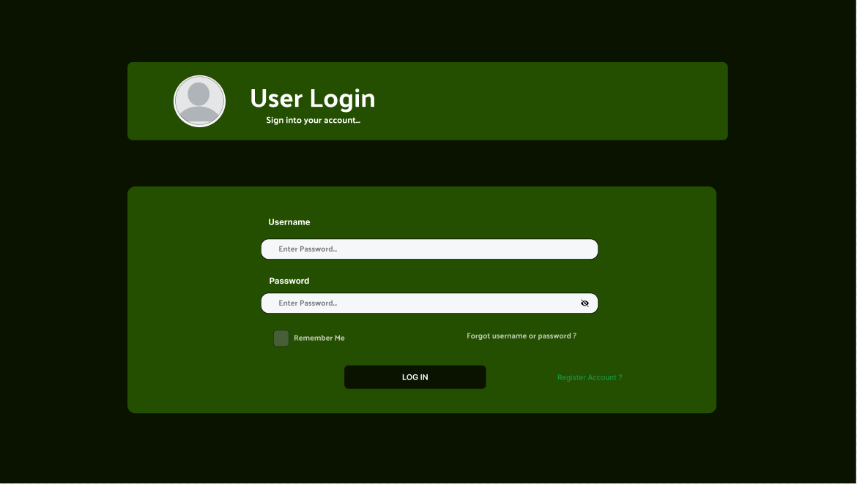

User Login Page

Slide 4
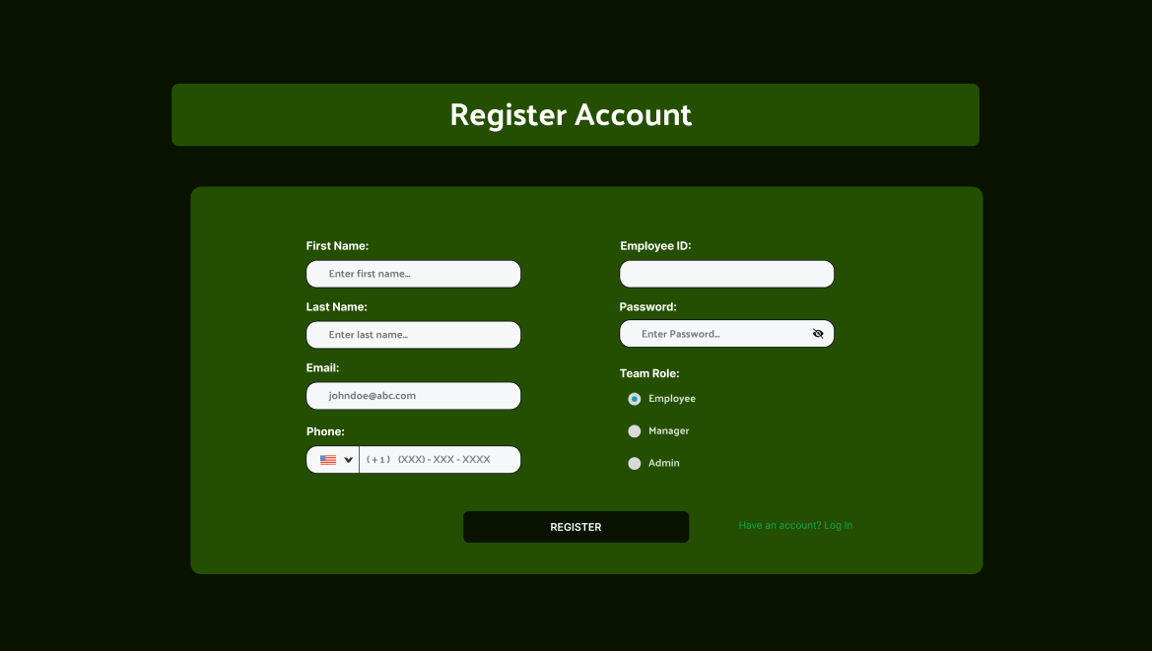
Registration Page

Slide 5
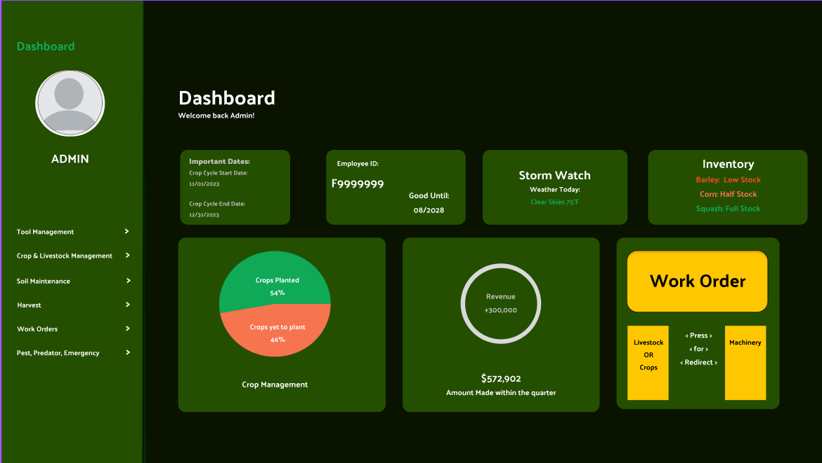

Slide 6
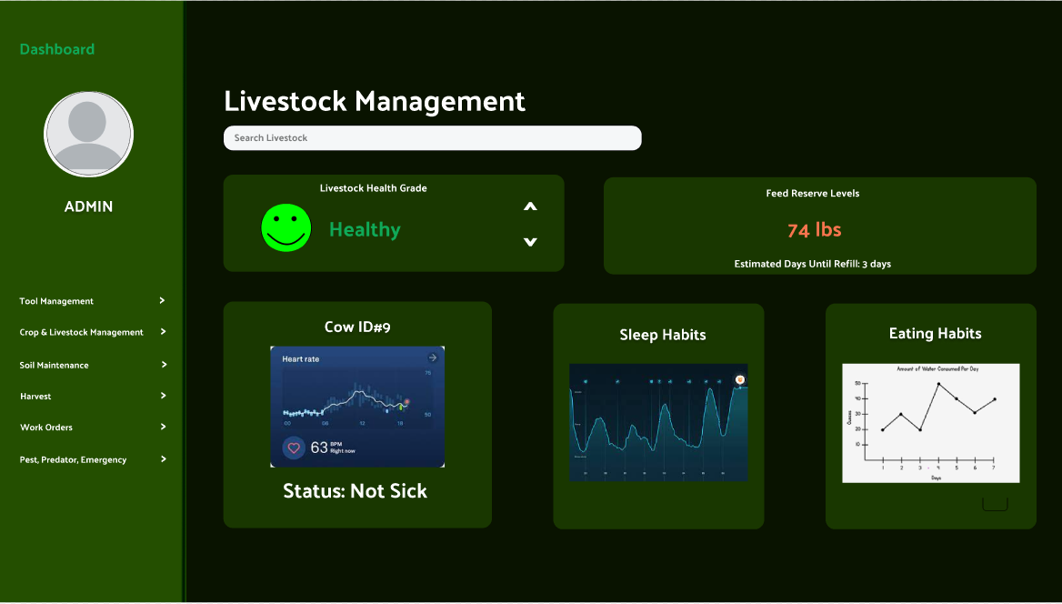
Livestock and Crop Tracking
Up to date vitals for each individual animal.
Automatic feeder status.
Livestock eating and sleeping history.
Livestock yield prediction
Maturity tracking for livestock

Slide 7
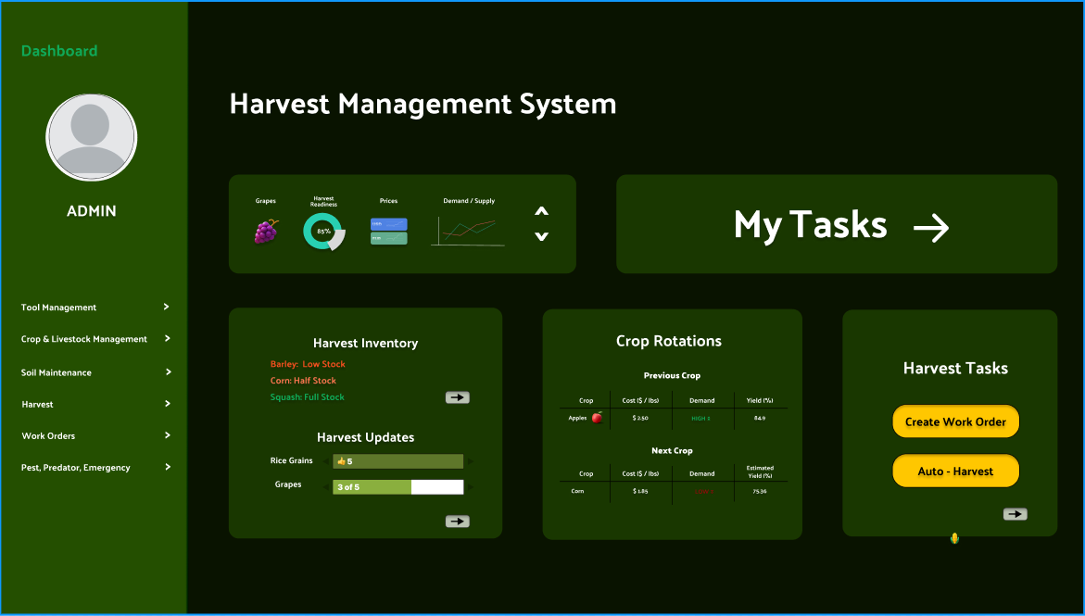
Harvest Management
Live crop market details
Task Hub
Harvest Inventory information.
Crop Rotation history and planning (%yield).
Initiate autonomous harvest

Slide 8
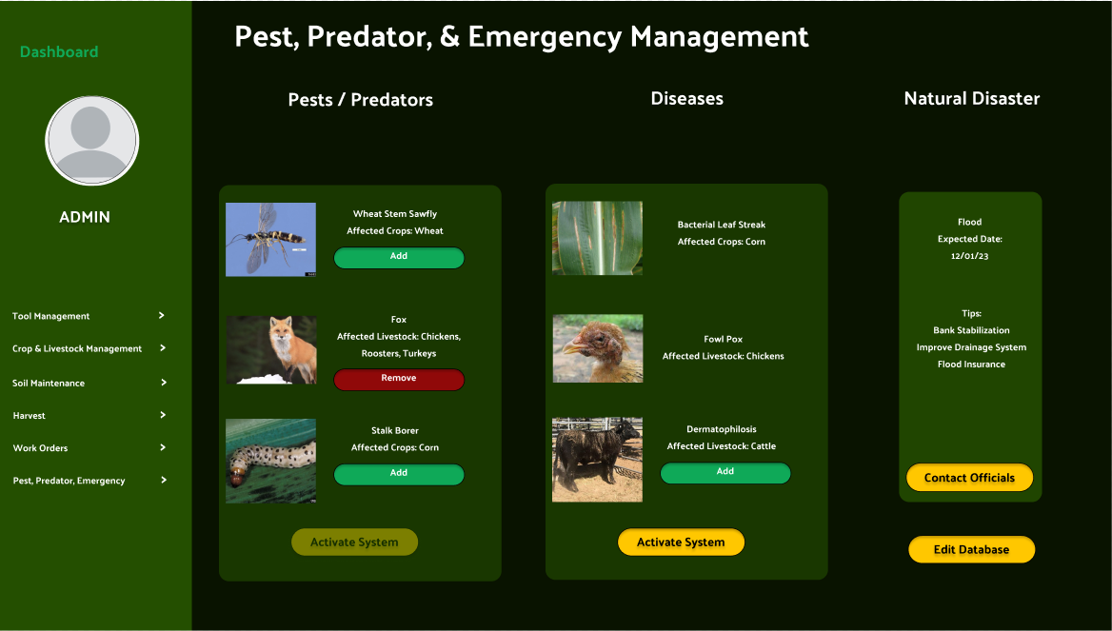
Pest, Predators and Emergency System
Pest and Predator
Prevention
Detection / Monitoring
Emergency Response System
Disease outbreak
Natural disasters

Slide 9
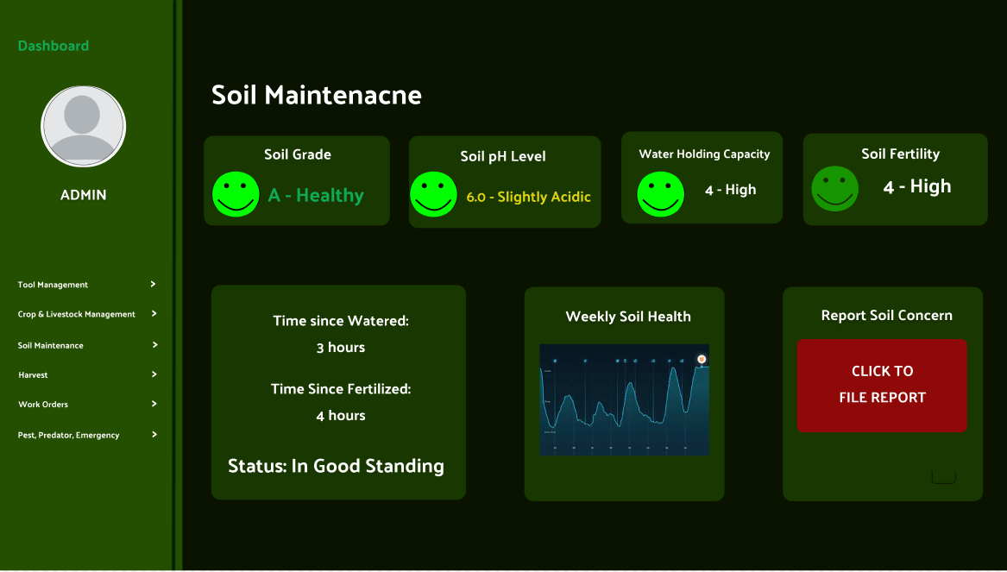
Soil Maintenance
Current soil conditions reporting
Visualization of soil condition history
Notes logging
Automated watering and fertilization history

Slide 10
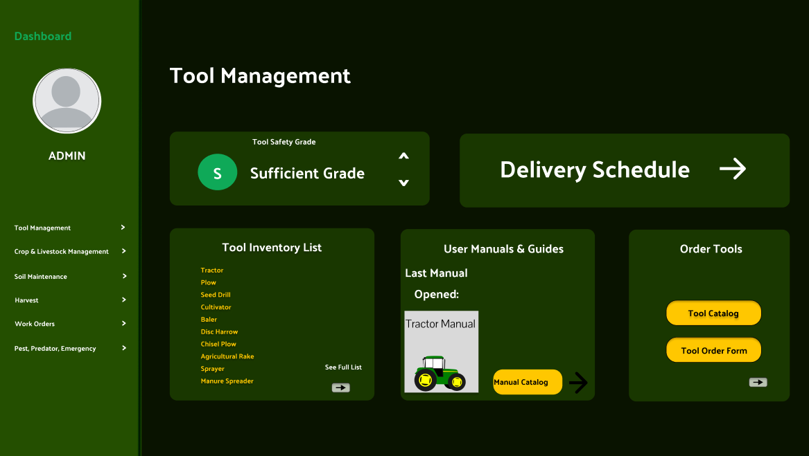
Tool and Equipment Management
Task Scheduling: for farmers (alerts and notifications)
Equipment Maintenance - electronic vehicle and tool maintenance log
Equipment Stock management (keep track of how many tools)
GPS Equipment Tracking (sensors on tools, where they are, missing tools alert/notifications)

Slide 11
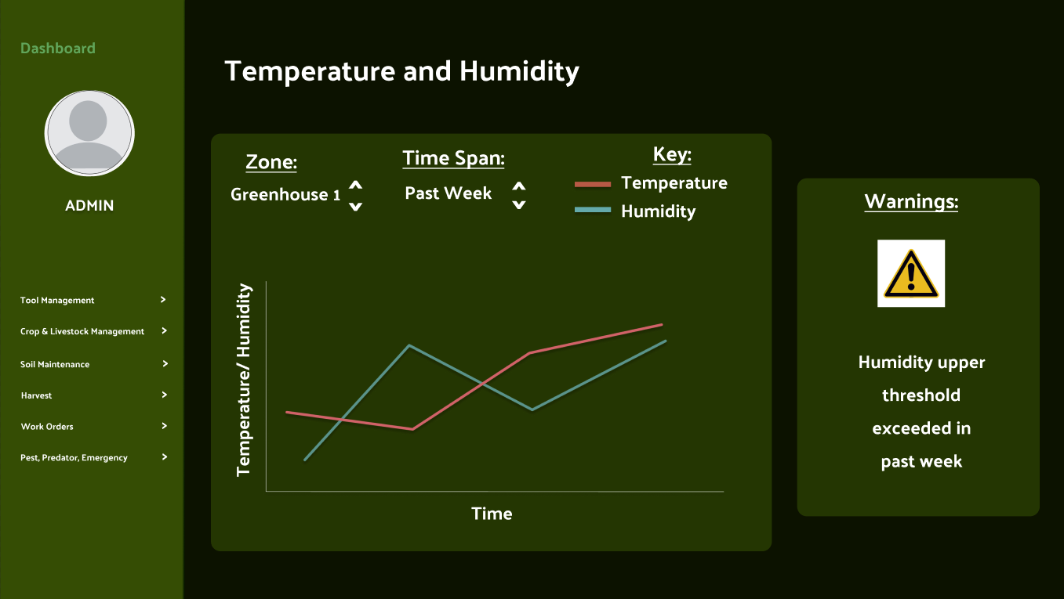
Sensors and Data Analysis Tools
Temperature monitoring
Humidity monitoring
Offline Data Collection - redundant system that functions without an internet connection

Slide 12
GitHub

Slide 13
Development Style
Due to robust nature of the SmartFarms system, there would be a lot of Risk Analysis and Management. Hence, the spiral model would be most appropriate.
Due to complex nature, significant changes should be expected along the way.

Slide 14
Challenges
Determining system scope
How many features were feasible for a semester long project
How to prioritize functionalities to focus on
How would a farmer like their app to function?
Distilling a complex interconnected system
Overlapping functional requirements

Slide 15
How We Overcame the Challenges
Divided features into six functional groups
Prioritized functionalities based on importance
Putting ourselves in the shoes of the user
Focused on the main algorithms and the heart of the implementation
Took critique from the TAs and applied it to our designs
Collaborated with one another to figure out how to display each requirement without overlap

Slide 16
Summary/Lessons Learned
Lessons Learned:
Pay attention to detail
The earlier you start being intentional and specific about your blueprint the easier it will be to bring it to life
Strategy:
We…..
Started out with a vague idea of the goal of the Smart Farm architecture.
Thought through the system's potential functionalities
Created modules and diagrams for the system’s parts
Created UI and pseudocode for the system

Slide 17
Questions?

